Slide 1
Analysis of Patient Length of Stay in General Medicine Service Line
Evaluation and Recommendations
Presented by: Augustine Ogbonnah
11/06/2024

Slide 2
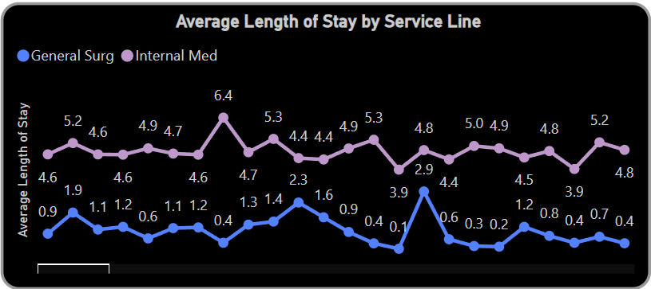
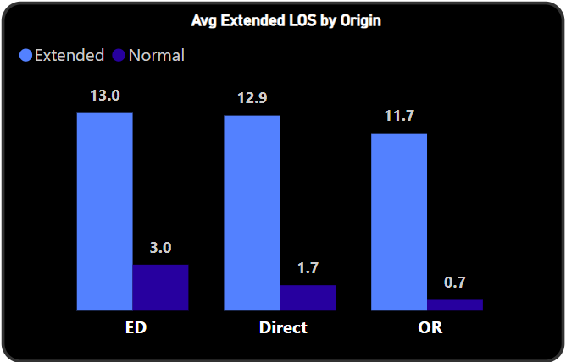
Data Analysis Overview Objective: To assess and compare Length of Stay (LOS) between the General Medicine and General Surgery service lines and evaluate contributing factors to prolonged LOS in General Medicine.
The above bar chart shows a clear comparison between General Medicine and General Surgery average LOS of 4.9 and 0.9 respectively.
Key Insight: General Medicine has a higher average LOS compared to General Surgery, suggesting potential areas for review and intervention.
The above chart illustrates how LOS varies by patient origin (e.g., Emergency Department vs. scheduled admissions) and highlights cases with extended LOS.
Key Insight: Emergency admissions tend to have a higher incidence of extended LOS, potentially due to complexity and urgency of cases.

Slide 3
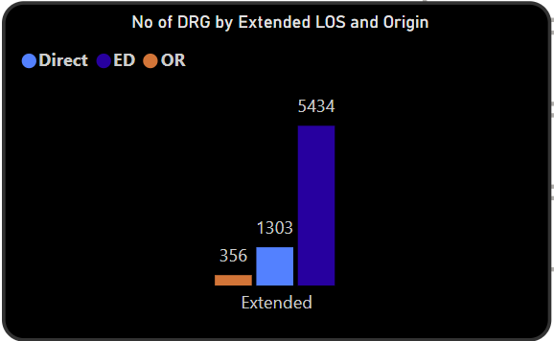
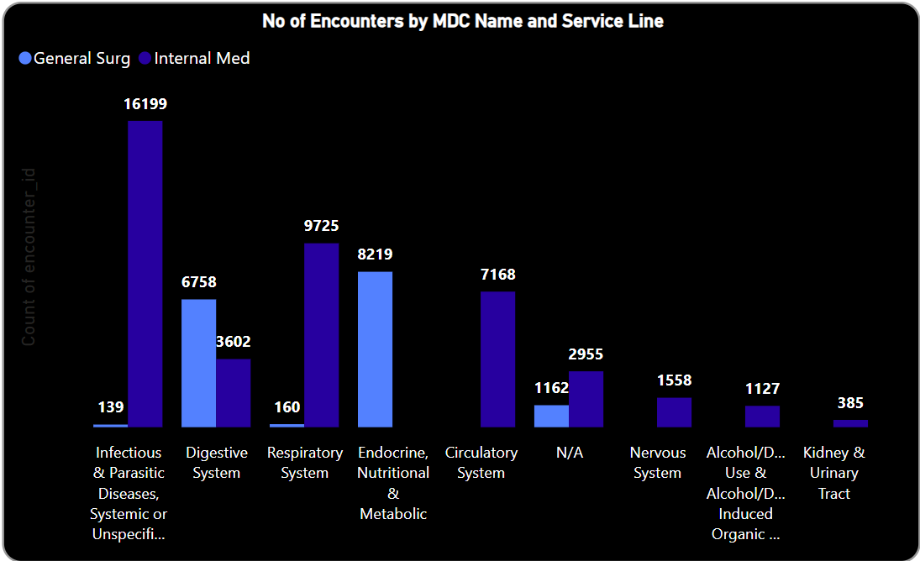
1. Seasonal Illnesses and Epidemics Flu Season: During peak flu season (typically October to May), hospitals experience an influx of respiratory cases, which can increase LOS due to complications, especially in elderly or immuno-compromised patients. Epidemics or Pandemics: Outbreaks like COVID-19 can drastically increase LOS for affected patients, requiring isolation protocols and intensive respiratory care. This also impacts hospital resources and bed availability. 2. Patient Socioeconomic Status Access to Post-Acute Care: Patients from low-income backgrounds may lack access to rehabilitation, skilled nursing facilities, or home healthcare, resulting in extended LOS while waiting for placement or support arrangements. Housing and Social Support: Homeless patients or those lacking stable housing and family support may have delays in discharge as hospitals coordinate alternative care arrangements or work with social services. 3. Availability of Post-Acute Care Facilities Skilled Nursing and Rehabilitation Facility Shortages: Limited availability in these facilities can delay discharge for patients requiring additional recovery time outside the hospital. Coordination with External Facilities: Lack of seamless communication or coordination with post-acute care providers may result in unnecessary delays, as transfers require careful planning. 4. Insurance and Financial Constraints Approval Delays: Some insurance providers require pre-approval for specific treatments or post-acute care services, which can delay transitions to lower levels of care. Coverage Gaps: Patients without comprehensive insurance coverage may experience delays due to limitations on covered services, affecting their ability to receive appropriate care promptly after discharge. 5. Staffing Levels and Availability Hospital Staffing Shortages: Staffing levels for nurses, physicians, and other key personnel can directly affect LOS. When staffing is low, patients may experience delays in receiving necessary care or discharge preparations. Specialist Availability: Limited access to specialists or consultants (e.g., psychiatrists, geriatricians) can delay diagnostic procedures, treatment adjustments, or discharge planning, especially for complex cases.
Interpretation of Findings Key Insights:
This chart reveals that Emergency Department transfers are associated with higher extended LOS cases.
Implication: Patients from certain origins, particularly emergency cases, are more likely to experience extended LOS, requiring targeted discharge and transition support.
Above chart shows encounters by Major Diagnostic Categories (MDCs), providing a breakdown of the types of cases driving LOS in each service line.
Conditions under certain MDCs, such as respiratory and infectious diseases, may account for longer stays in General Medicine. The period covered by the data are inside flu season hence the seemingly high LOS.
Overall Implications:
The data indicate that higher LOS in General Medicine may be linked to the complexity of cases and emergency admissions, rather than inefficiency. However, some areas might benefit from targeted interventions to streamline patient flow. The above external factors affect LOS.

Slide 4
Recommendations
Short-Term Strategies:
Enhanced Discharge Planning:
Initiate discharge planning early in the admission process for high-LOS DRGs.
Implement fast-track pathways for low-complexity cases to reduce unnecessary delays.
Multidisciplinary Rounds:
Conduct daily rounds with interdisciplinary teams to address potential discharge barriers early.
Focus on patients identified as having extended LOS risk to expedite care and discharge readiness.
Long-Term Strategies:
Preventive Care Initiatives:
Develop programs aimed at managing chronic conditions to reduce acute admissions that often result in extended LOS.
Data-Driven Identification of High-LOS Cases:
Leverage data analytics to identify patients likely to experience longer stays upon admission, allowing for proactive case management.
Expected Outcomes:
Reduced LOS in General Medicine by optimizing bed utilization and ensuring that resources are directed toward complex, high-need patients.

Slide 5
Conclusion
Summary of Key Findings:
General Medicine has a longer LOS than General Surgery, largely due to patient complexity and emergency admissions.
Flu Season: Flu and other respiratory illnesses like pneumonia, COPD exacerbations, and bronchitis are more prevalent from October to May, with peaks typically between December and February.
LOS may increase for respiratory-related DRGs during these months, as treatment and recovery for conditions like influenza pneumonia can be prolonged.
Certain diagnostic categories (e.g., respiratory, infectious) are linked to extended LOS, underscoring the need for specialized care protocols. Thus, General Medicine high LOS of 4.9 (but within industry benchmark) is not due to inefficiency
Future Action Plan:
Implement recommendations through pilot programs to monitor effectiveness.
Continue collaboration with General Surgery to ensure efficient bed utilization and maintain a balanced patient flow.
Closing Note:
By leveraging these insights, the General Medicine service line can improve bed availability, streamline patient care, and support a more efficient hospital system overall.

